Slide 1
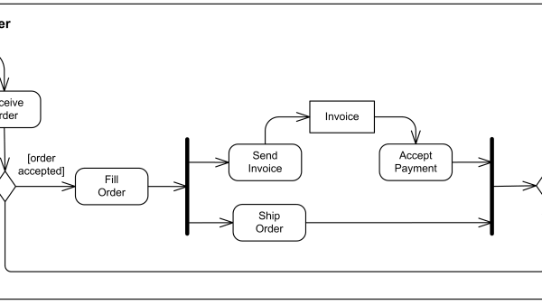
UML Behavioral Modeling
Activity Diagrams
Transforming complex logic into clear, visual workflows
Behavioral
Process
UML Diagram
Flow Modeling

Slide 2
Introduction & Overview
Activity Diagram Overview
Definition
Key Characteristics
An Activity Diagram is a behavioral UML diagram that visualizes the flow of control and data within a system.
Process-Focused
Emphasizes the process flow rather than the objects performing the actions
Function
Step-by-Step Visualization
It visualizes the flow of control and data within a system, describing how actions are performed step-by-step.
Describes how actions are performed sequentially with clear control flow
Behavioral Representation
Goal
Captures dynamic system behavior through control and data flow modeling
Represents the system's dynamic behavior clearly, emphasizing process flow over objects performing actions.
Diagram Type:
Behavioral UML

Slide 3
Introduction & Overview
Basic Activity Diagram Elements
Action
Start Node
Activity / Action
Decision Node
Control Flow
End Node
Indicates the beginning of the process workflow
Represents a specific task or operation being performed
Point where flow splits based on condition (Yes/No)
Arrows indicating sequence and direction of activities
Marks the completion of the entire process
Filled Circle
Rounded Rectangle
Diamond Shape
Directional Arrows
Bullseye
Key Principle
These five elements form the foundation of every activity diagram. They create a complete workflow by defining where the process starts, what actions are performed, how the flow proceeds, when decisions are made, and where the process ends.

Slide 4
Introduction & Overview
Purpose of Activity Diagrams
Visualization
Simplification
Primary Purpose
Complexity Management
Helps in mapping out system workflows and business processes visually, making abstract concepts tangible.
Makes complex algorithms and logic easy to understand through visual representation.
Visualize complex workflows
Break down complex logic
Map business processes
Reveal hidden dependencies
Create process blueprints
Improve code understanding
Collaboration
SDLC Phase
Communication Bridge
Development Lifecycle
Improves communication between technical developers and non-technical stakeholders.
Primarily used during the analysis and design phases of development.
Requirements analysis
Bridge communication gaps
System design
Align business and technical teams
Process optimization
Enable requirement validation
Core Value: Activity diagrams serve as a universal language that bridges the gap between business requirements and technical implementation, ensuring all stakeholders share a common understanding of system behavior.

Slide 5
Usage & Application
When to Use Activity Diagrams
Business Modeling
Algorithm Logic
High-Level Processes
Complex Operations
To depict high-level business processes and workflows (e.g., Order Processing).
To model the internal logic of a complex operation or function.
Order-to-cash workflows
Sorting algorithms
Customer onboarding
Decision trees
Approval hierarchies
State machines
Example:
E-commerce Checkout
Example:
Payment Validation
Use Case Elaboration
Concurrent Operations
Detailed Flow
Parallel Processing
To detail the flow of events described in a specific Use Case.
To visualize processes that happen in parallel (multithreading or distributed systems).
User registration flows
Authentication sequences
Multithreaded apps
Transaction processes
Async processing
Resource sharing
Example:
User Login Flow
Example:
Data Pipeline

Slide 6
Usage & Application
Why We Use Activity Diagrams
Clarifying Logic
Identifying Bottlenecks
Requirement Gathering
Documentation
Ideal for identifying "if/else" conditions and loops in a system.
Helps analysts see where a process might stall or become inefficient.
Ensures all alternative paths and error scenarios are accounted for before coding.
Serves as a blueprint for developers and a reference for testers.
Expose all conditional paths
Spot performance issues
Living documentation
Visualize loop structures
Identify resource conflicts
Capture all scenarios
Testing reference
Reveal edge cases
Optimize workflows
Prevent missing requirements
Knowledge transfer
Validate with stakeholders
40%
30%
50%
Fewer requirement defects
Faster development cycles
Improved team alignment
Key Insight: Activity diagrams provide ROI by catching issues early, when they're cheapest to fix. A diagram that costs 2 hours to create can save 20+ hours of rework.

Slide 7
Components Breakdown
Main Components of Activity Diagrams
Action
1
2
3
4
Initial Node
Activity / Action
Control Flow
Decision Node
Starting Point
Task/Operation
Sequence Arrows
Conditional Branch
6
7
5
8
Fork Node
Join Node
Merge Node
Final Node
Parallel Split
Sync Point
Path Recombination
End Point

Slide 8
Components Breakdown
Component: Initial Node
Symbol
Shown as a filled black circle
Function
Visual Representation
Represents the starting point of the activity diagram. Indicates where the workflow begins and triggers the first action in the process flow.
Initial Node
Requirement
Every activity diagram must have exactly one initial node. This ensures a single, well-defined starting point for the workflow.
First Action
Rule
The initial node has no incoming flows and one outgoing flow to the first activity or action.

Slide 9
Components Breakdown
Component: Activity / Action
Symbol
Real-World Examples
Action
Rounded Rectangle
Login
User Login Process
Shown as a rounded rectangle with the action name inside. The rounded corners distinguish it from other UML elements.
Select
Select Product
Function
Pay
Make Payment
Represents a single step or task in the process. Describes what action is being performed in the system at a specific point in the workflow.
Validate Input
Validate
Granularity
Naming Convention
Flow Connection
Activities can represent high-level business processes or low-level system operations, depending on the diagram's purpose.
Use verb-object format (e.g., "Validate Order", "Generate Report") for clarity and consistency.
Each activity has incoming and outgoing control flows, connecting it to other diagram elements.
Best Practice: Keep activity names concise yet descriptive. Use strong action verbs and clear nouns to eliminate ambiguity.

Slide 10
Components Breakdown
Arrow Types
Component: Control Flow
Sequential Flow
Default progression
Symbol
Vertical Flow
Directional Arrows
Top-to-bottom layout
Return Flow
Loops and cycles
Function
Key Characteristics
Shows the sequence of activities, indicating the order in which actions are performed.
Unidirectional: Shows clear progression
Action 1
Action 2
Connects Elements: Links all components
Shows Order: Defines execution sequence
No Conditions: Straightforward routing
Direction
Indicates the path of process flow from start to finish, creating a complete workflow narrative.
Process
Remember: Control flows are the glue that holds the diagram together.

Slide 11
Components Breakdown
Component: Decision Node
Symbol
Behavior
Diamond Shape
Function
1
One Input
Used when a decision or condition is required to determine the next step in the workflow.
Has a single incoming flow from a preceding action or node.
2+
Multiple Outputs
Action
Has two or more outgoing paths representing different conditions.
Path A
Path B
Labeling
Guard Conditions
Completeness
Each path labeled with specific conditions: [Yes] , [No] .
Use boolean expressions in square brackets to specify conditions.
Ensure all possible conditions are covered to prevent undefined behavior.

Slide 12
Components Breakdown
Component: Merge Node
Symbol
Diamond Shape (Inverted)
Function
Used to combine multiple alternative paths back into a single unified flow after a decision.
Path A
Path B

Slide 13
Components Breakdown
Component: Fork Node
Symbol
Benefits & Usage
Thick Bar
Improves Efficiency
Function
Execute independent tasks simultaneously, reducing total processing time.
Used to split the workflow into parallel activities, enabling concurrent execution.
System Performance
Leverages multithreading and distributed computing capabilities.
Before
Complex Workflows
Task 1
Task 2
Task 3
Models real-world scenarios where multiple activities occur in parallel.
Multithreading
Distribution
Independency
Performance
Enables concurrent execution in multi-core processor systems.
Models processes across multiple servers or systems.
Best for tasks that can run without dependencies.
Critical paths can execute while others prepare data.

Slide 14
Components Breakdown
Component: Join Node
Symbol
Thick Bar (Same as Fork)
Key Points
Function
Synchronization: All threads must finish
Used to synchronize parallel activities back into a single unified flow after a fork.
Blocking: Waits for the slowest thread
Coordination: Ensures proper sequencing
Task 1
Task 2
Completeness: Validates all work is done
After
Rule
The process continues only after ALL incoming parallel activities have finished.
Synchronization Rule
Waits for all paths to complete

Slide 15
Components Breakdown
Component: Final Node
Symbol
Multiple Final Nodes
Bullseye (Concentric Circles)
A diagram may contain more than one final node if there are multiple end states or termination points.
Function
Represents the end of the activity diagram, indicating that the entire process has finished successfully.
Successful Completion
Process ends normally
Final Action
Meaning
Error Termination
Process ends due to error
Indicates that the entire process has finished and all workflow activities are complete.
Process Complete
Early Exit
Workflow terminated
Process ends prematurely
Termination
Completion
Cleanup
No outgoing flows. The process stops completely when it reaches a final node.
Represents successful completion of all workflow activities.
Often triggers resource cleanup and final state updates.

Slide 16
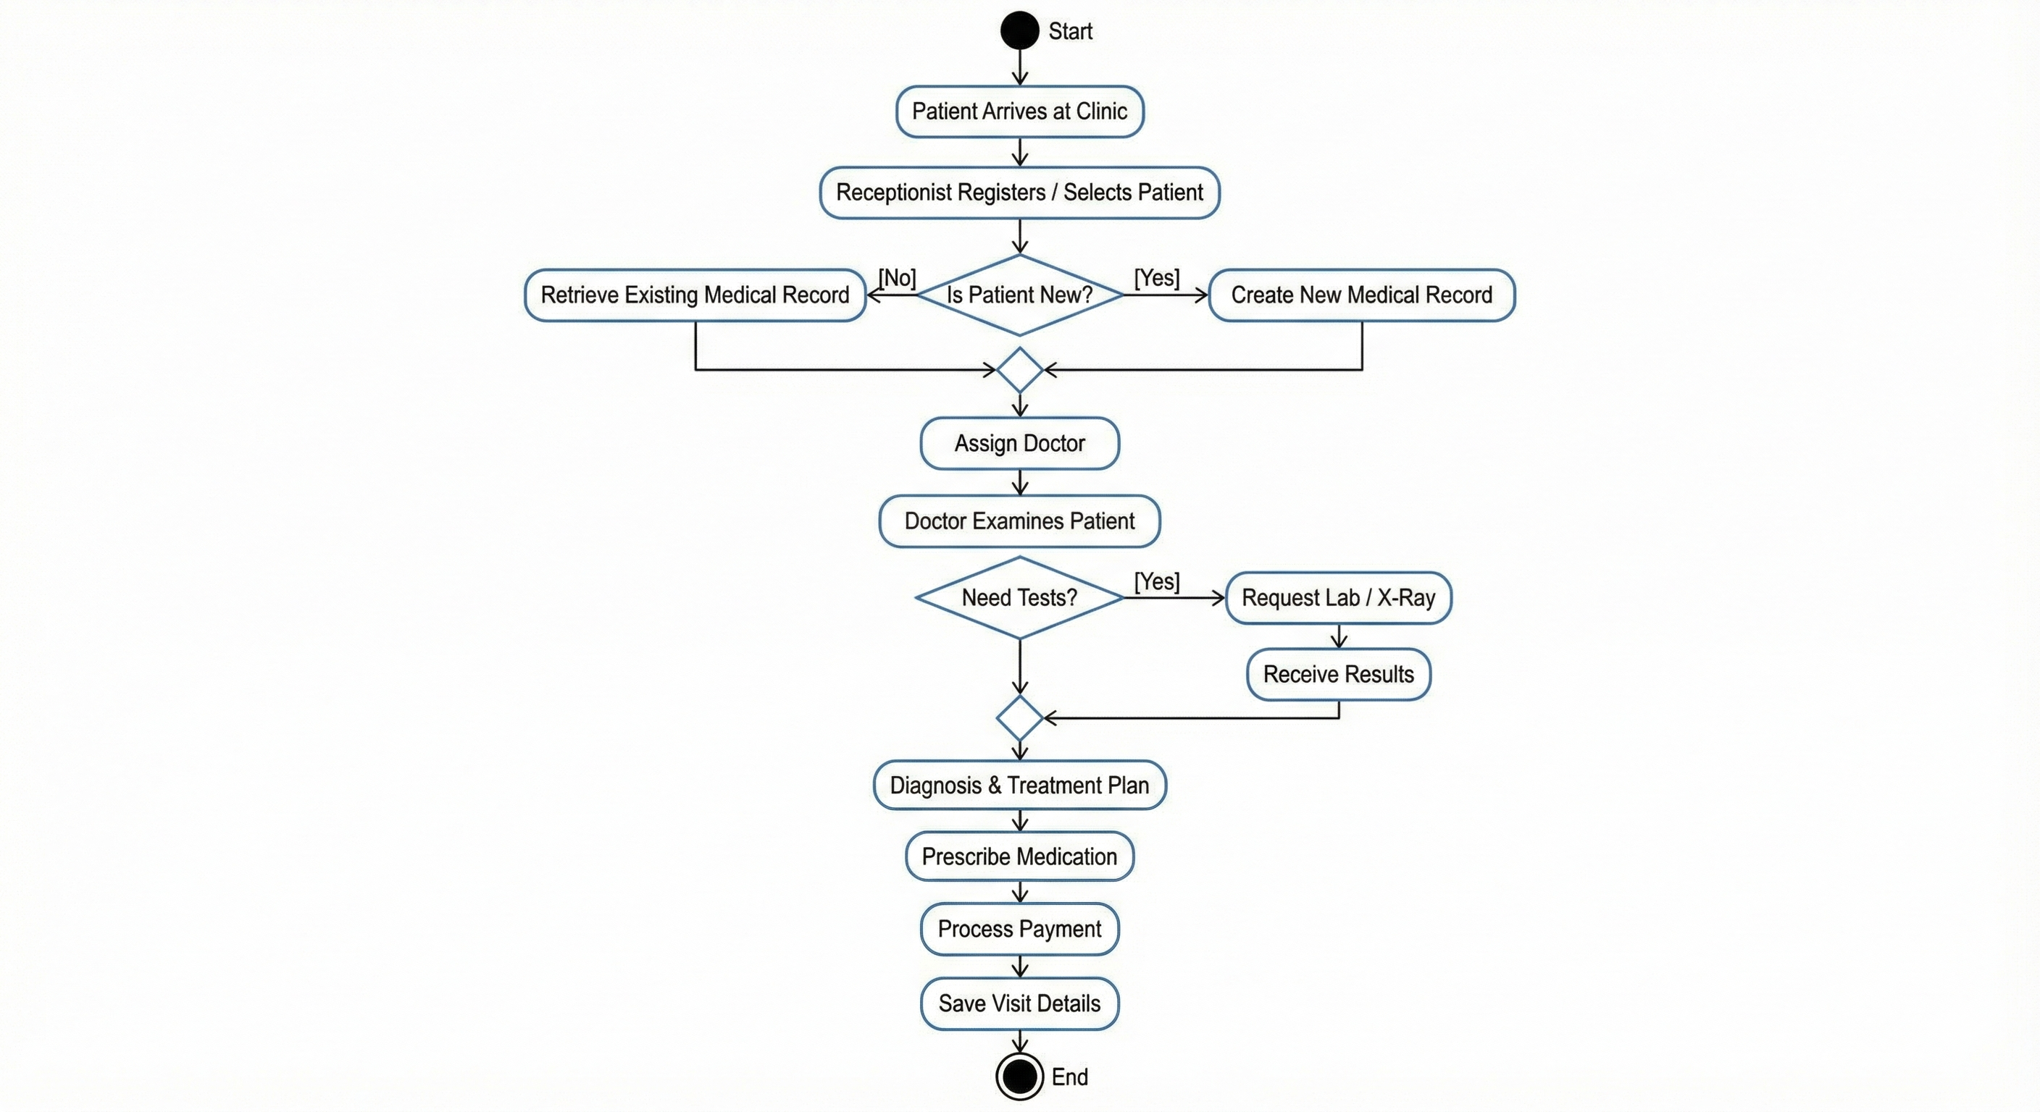
Real-World Example
Clinic Management System

